Slide 1
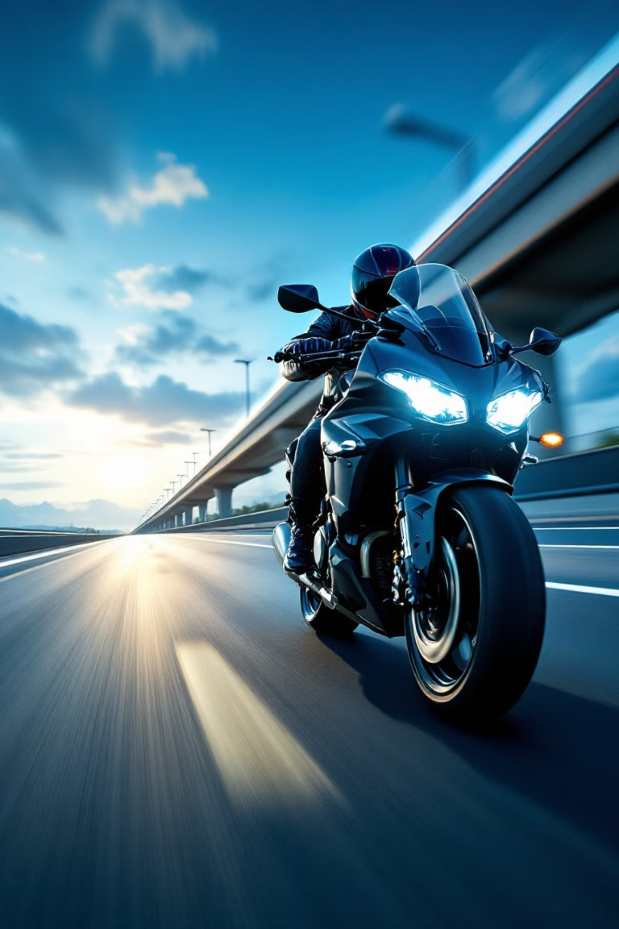

Automated Helmet & Rider Detection System for Road Safety
A State-of-the-Art Hierarchical Object Detection Approach using YOLOv8
Sahil Goyat Roll No. S20220010190
M. Mamatha Roll No. S20220010143

Slide 2


Problem Statement & Objective
The Problem
Our Objective: Robust Real-Time System
Manual traffic monitoring is inefficient and error-prone
Identify Rider
(Context)
Traditional AI models fail in complex scenes (e.g., mistaking pedestrians for riders)
Determine Compliance
(Helmet vs. No Helmet)

Slide 3
Our Data Sources: The Foundation of Accuracy
To build a robust and reliable system, we meticulously curated a comprehensive dataset from diverse sources, ensuring variety in rider postures, helmet types, lighting conditions, and traffic scenarios.
Imroved helmet detection (Custom made dataset) consist of two datasets
(a) kaggale: Helmet_Detection_Person_with_and_without_helmet,
1
https://www.kaggle.com/datasets/andrewmvd/helmet-detection
(b) Roboflow: Motorcycle Helmet Detection Computer Vision Dataset
https://universe.roboflow.com/data-science-173-msp9r/motorcycle-helmet-detection
** four classes: full-faced, half-faced, invalid, no helmet** (converted into two classes : helmet and no helmet)
helmet Computer Vision Dataset (Roboflow)
2
https://universe.roboflow.com/ae100886/helmet-nyoon
** Two classes: helmet no helmet**
Helmet Detection Computer Vision Dataset (Roboflow)
3
https://universe.roboflow.com/workspacedwem/helmet-detection-7ucaz
** Two classes: helmet no helmet**
rider Computer Vision Model(Roboflow)
4
https://universe.roboflow.com/helmet-xpr1k/rider-yb2yp
**Rider class only.**

Slide 4



Data Engineering: The "Ultimate Dataset"
21,862
3
512
Total Images
Classes
Input Size
Aggregated from 5 sources: Roboflow Universe, Kaggle, Custom
rider, helmet, no helmet
512 x 512 pixels
77%
15%
8%
Training
Validation
Testing
~17,000 images
~3,200 images
~1,700 images

Slide 5
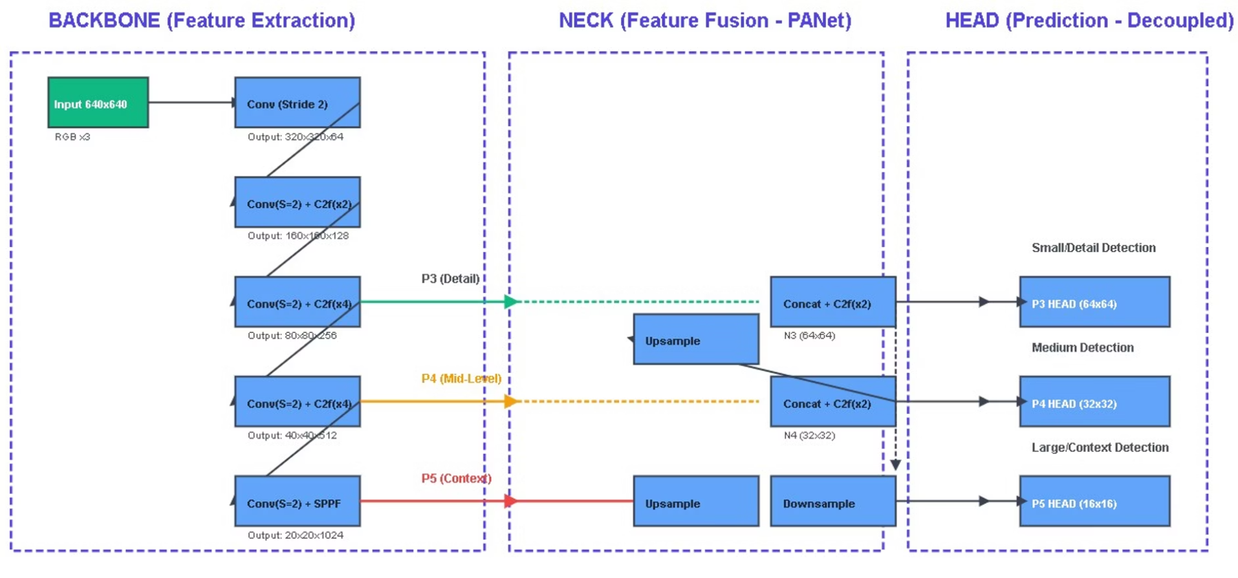
YOLOv8m (Medium) Architecture:
Model Specifications (Type) : Single-Stage, Anchor-Free Object Detector
Parameters: 25.9 Million (Trainable)
Head: Decoupled
Separate branches for Classification and Regression
Neck: PANet
Path Aggregation Network for multi-scale feature fusion
Backbone: CSPDarknet53
C2f modules for rich feature extraction and SPPF for global context

Slide 6
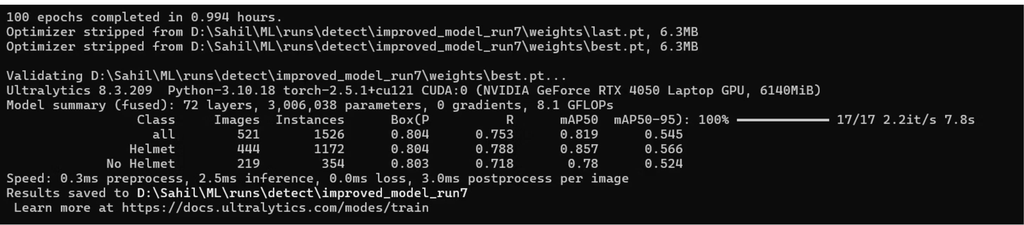
Training Strategy: Inductive Transfer Learning (Fine-Tuning)
Pre-trained Foundation
Initialized with weights pre-trained on the COCO dataset (yolov8m.pt)
Strategic Advantage
Accelerated Convergence: The model already knows how to detect general objects (people, cars) and features (edges, textures). This allows it to skip the initial, slow learning phase.
Improved Accuracy: It transfers general knowledge to your specific, smaller domain (helmet detection), achieving higher accuracy than training from scratch.
Customization: The weights are then fine-tuned over 150 epochs specifically on your 21,862 custom helmet/rider images to specialize in traffic violations.

Slide 7


Implementation Platform
Training Parameters
Hardware
Batch Size: 16
NVIDIA GeForce RTX 4050 Laptop GPU
Optimizer: SGD with momentum
Epochs: 150 (Early Stopping patience=25)
Augmentations: HSV shifts, Horizontal Flip (50%)
Framework
PyTorch via Ultralytics YOLOv8 library
yolo detect train data="data/Ultimate_Data/data.yaml" model=yolov8m.pt epochs=150 imgsz=512 name=final_sota_150epochs batch=16 augment=True hsv_h=0.015 hsv_s=0.7 hsv_v=0.4 fliplr=0.5 patience=25

Slide 8



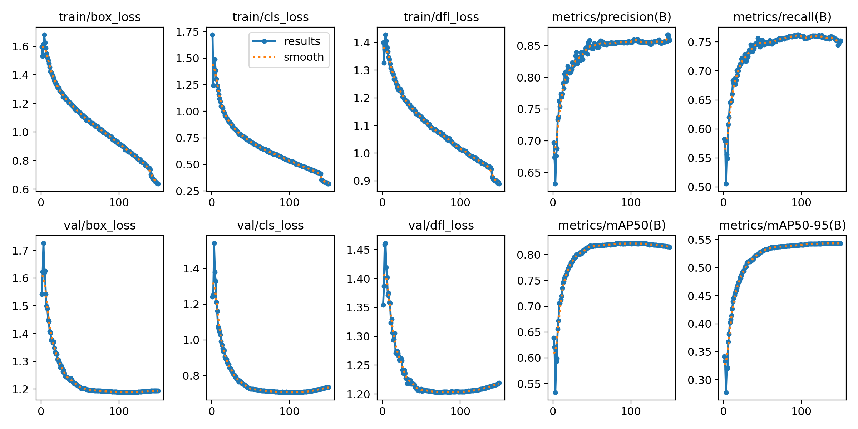
Loss Function & Training Convergence
Box Loss (CIoU)
Cls Loss (BCE)
DFL
Complete Intersection over Union for bounding box regression
Binary Cross Entropy for classification accuracy
Distribution Focal Loss for fine-grained box boundary refinement
Training Behavior: Converging
Both Training and Validation losses decreased steadily until Epoch ~120, after which they stabilized, confirming the model converged without significant overfitting.

Slide 9
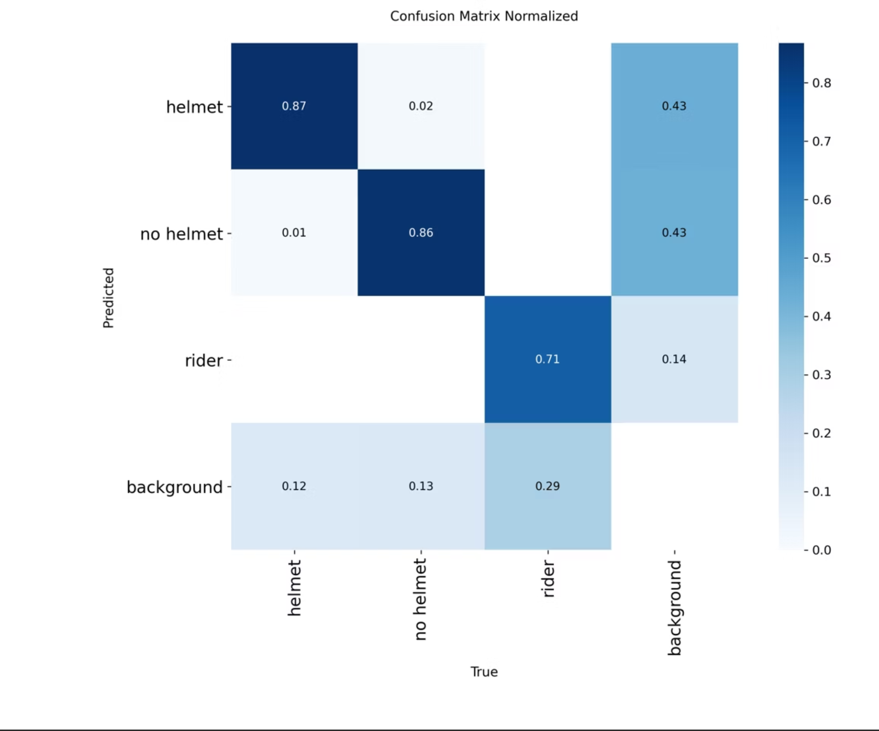

Results
82.2%
Mean Average Precision (mAP@50) - Excellent Reliability
Precision
85.9%
High trust; few false positives
75.2%
Recall
Good coverage of objects
Inference Speed
Real-time capable: ~3-6ms per image on GPU

Slide 10
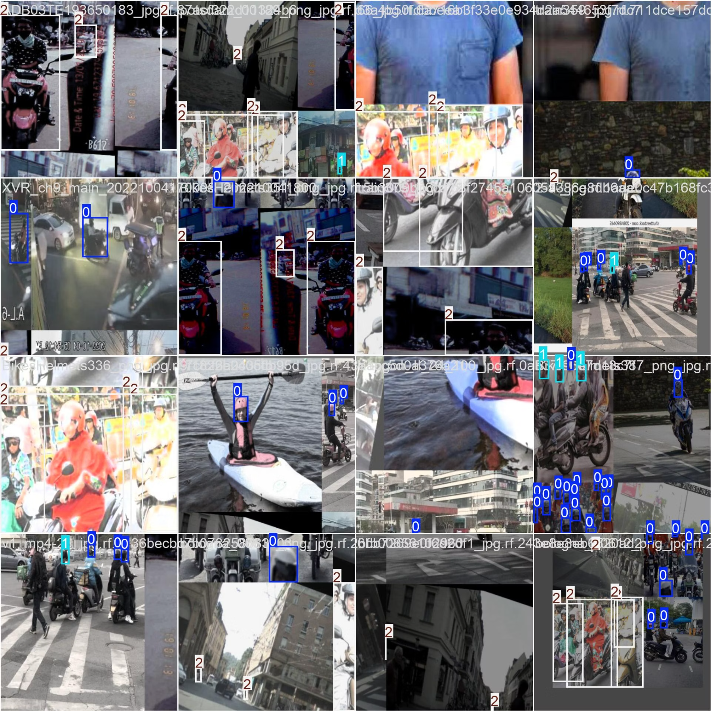
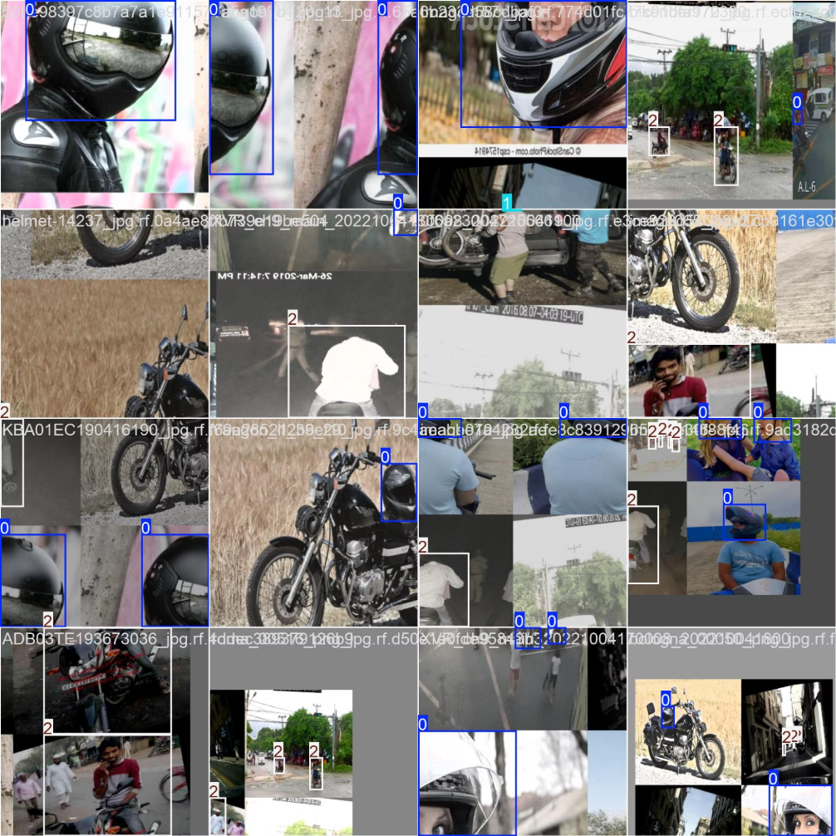
Results

Slide 11
Comparison & Limitations
Comparison with Research
Limitations
Some papers claim ~93% mAP using small, curated datasets
Recall for rider class is slightly lower due to missing labels in some sub-datasets
Our 82.2% achieved on 22k image uncurated dataset
Advantage: Our model is more generalized for the real world
"While we didn't beat the 93% benchmark numerically, our result is arguably more valuable. Achieving 82% on a massive, diverse dataset means our model is field-ready, whereas models trained on small datasets often fail when the camera angle changes."

Slide 12
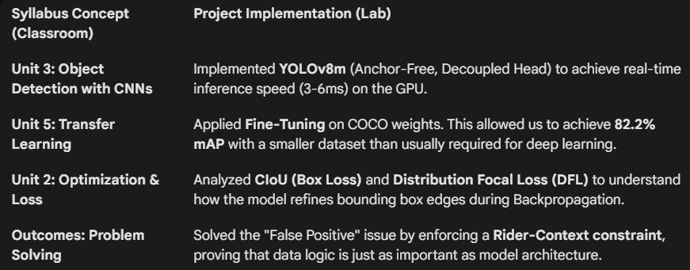
Key Learnings & Observations
Data Engineering is Key
Context Matters
Real-World Trade-off
Improving data quality (cleaning labels, merging datasets) had a bigger impact on performance than changing model hyperparameters
Moving from a 2-class system to a 3-class hierarchical system
Achieving 82% on a massive, diverse dataset (22k images) represents a more robust model ready for real-world deployment in varying lighting and angles
(rider → head) significantly reduced false positives by providing context

Slide 13
Thank You

